Slide 1
Introduction to GIS
through Quantum GIS
Day 1: Software Day
offered by Valley Stewardship Network
taught and prepared by Legion GIS, LLC
July 2016

Slide 2
What is (a) GIS?
Geographic Information System =
a map that is also a database, i.e. a spatial database
Here’s an example we’re all familiar with…

Slide 3
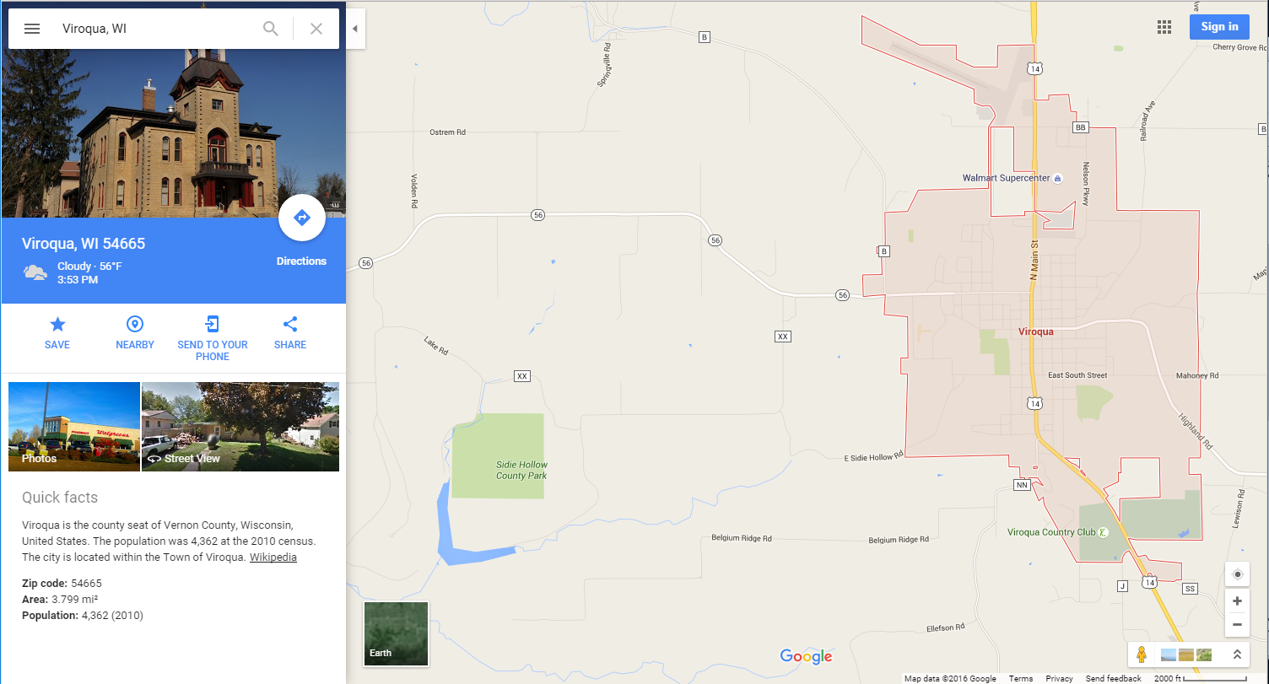
google maps = a super fancy GIS

Slide 4
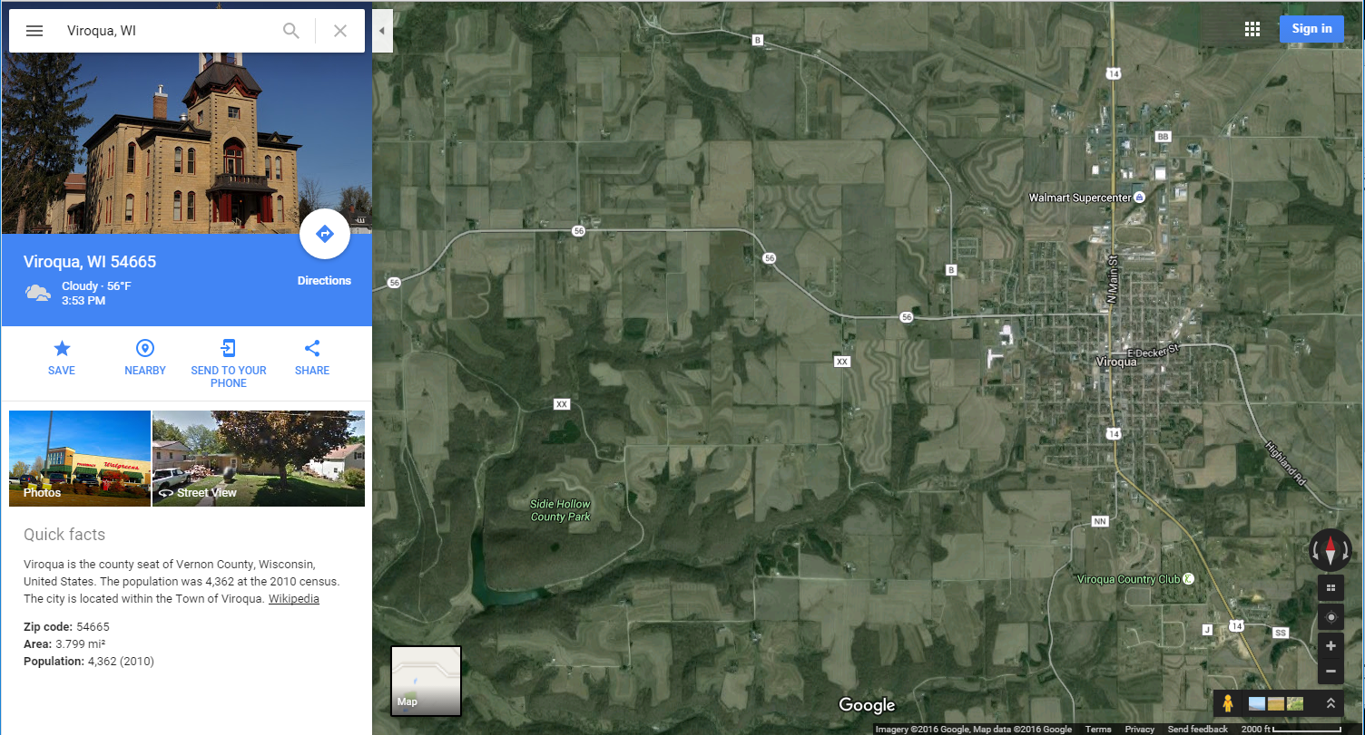
google maps = a super fancy GIS

Slide 5
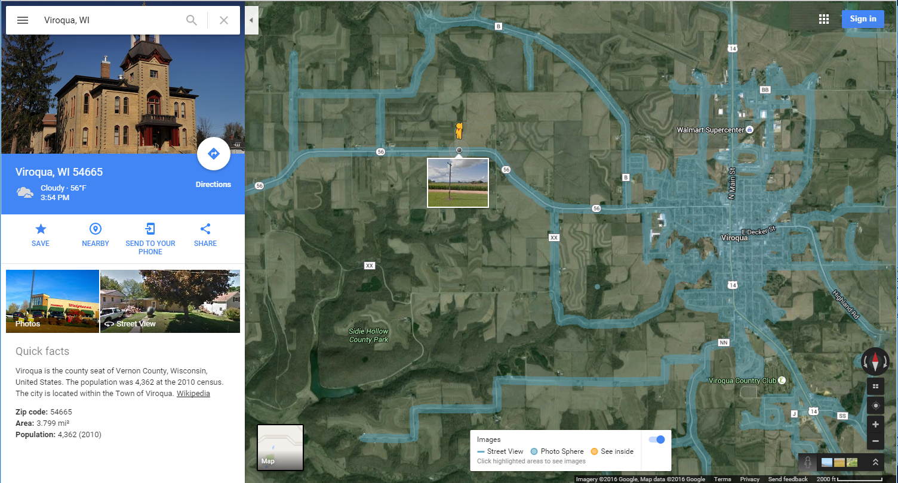
google maps = a super fancy GIS

Slide 6









data
planes/remote sensing
shapefiles
spreadsheets
satellites/GPS
processing
this is technically the “Geographic Information System” part…
publishing
web-map
real map
mobile app

Slide 7

data
planes/remote sensing
shapefiles
spreadsheets
satellites/GPS
processing
this is technically the “Geographic Information System” part…
publishing
web-map
real map
mobile app

Slide 8
Another way to look at the steps involved…
Data management
Creation, collection, acquisition
Data analysis
Modeling, comparison, processing
Data interpretation
Visualization, publication, dissemination
…and there is software all along the way.

Slide 9
In a lot of ways, it’s pretty much just IT.
GPS unit accompanying software for collection/correction
Trimble PathFinder, etc.
Software for processing remote sensing products
LASTools (for raw LiDAR data), ENVI (for image processing)
Purely analysis-based software
GRASS GIS (for modeling), various Python or R modules
Mapping software
ESRI’s ArcGIS (with extensions for all kinds of processes), Quantum GIS (with plugins), GRASS (for modeling), MapInfo, OpenJUMP, TileMill (for style and creating tiled image)
Any number of web-related technologies
OpenLayers, Leaflet, GeoServer, MapServer, CartoDB, MapBox, GeoDjango

Slide 10




Desktop vs. Server-Side software
Desktop is installed and used on your computer
+
=
Server-side software is installed on a server somewhere, and you access it through the internet
http

Slide 11
About software development and licensing:
Open Source vs. Proprietary
FOSS (Free and Open Source Software)
developed in the public domain
anyone can use it, contribute, or create plugins
published under one of many open source licenses
free
Proprietary Software
developed and copyrighted by an entity
licensing and use depend on the product
(e.g. MS Office business license vs. home license)
generally not free, potentially very expensive

Slide 12




Open source technology encourages interoperability between platforms and software… no real incentive to create completely stand-alone applications. For example:
Quantum GIS
Uses GDAL/OGR tool libraries
Allows for close integration with Python programming language
Supports the integration of plugins created by people anywhere

Slide 13
Proprietary vs. open extends to data:
But open data is everywhere!
Open data
e.g. the majority of US government data
accessible to the public
free, or small “time and materials” fees
Proprietary Data
e.g. an energy company’s customer address list
not accessible to the public (in raw format)
if it is accessible, generally not free

Slide 14

google maps = a proprietary GIS

Slide 15
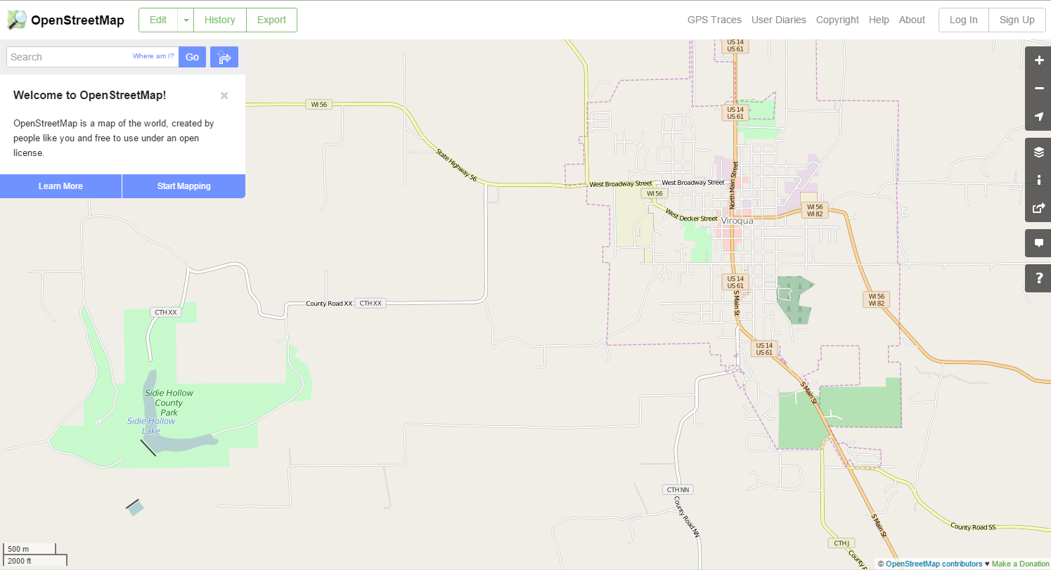
open street map = an open GIS

Slide 16
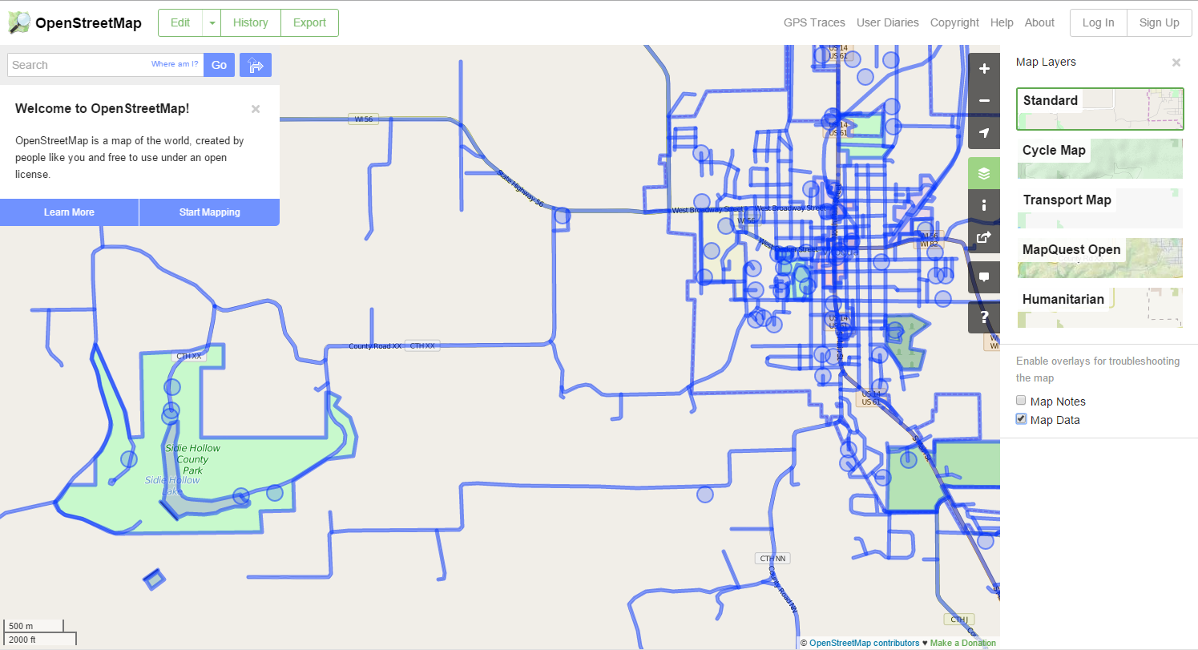
…anyone can enter or correct data

Slide 17

questions and break time…

Slide 18
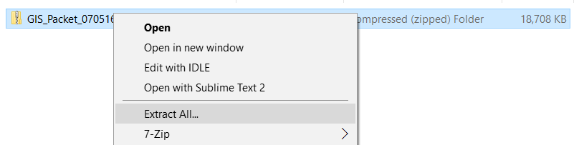
Quick note on zip files!
Zip Files are compressed folders that must be “unzipped” before you can use them.
Right-click on the file to unzip
Once unzipped, the normal “folder” icon will be used

Slide 19
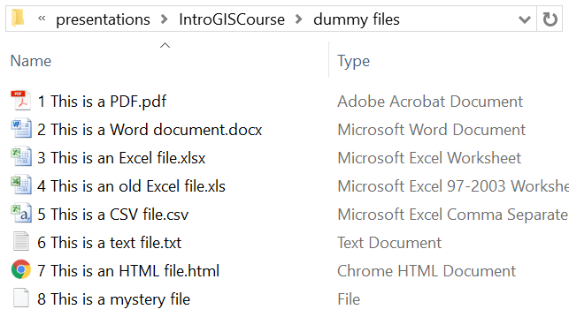
Quick note on file extensions!
File extensions are the part of the filename that tell your computer how to interpret the file, i.e. what program to use to open it.
Again, GIS is basically data storage and interpretation.

